Slide 1
Chapter 7 -
Advanced Text Generation Techniques and Tools
From the book Hands-On Large Language Models

Slide 2
Important Topics
Model I/O (Input/Output): Loading and working with LLMs
Memory: Helping LLMs to remember
Agents: Combining complex behavior with external tools
Chains: Connecting methods and modules

Slide 3
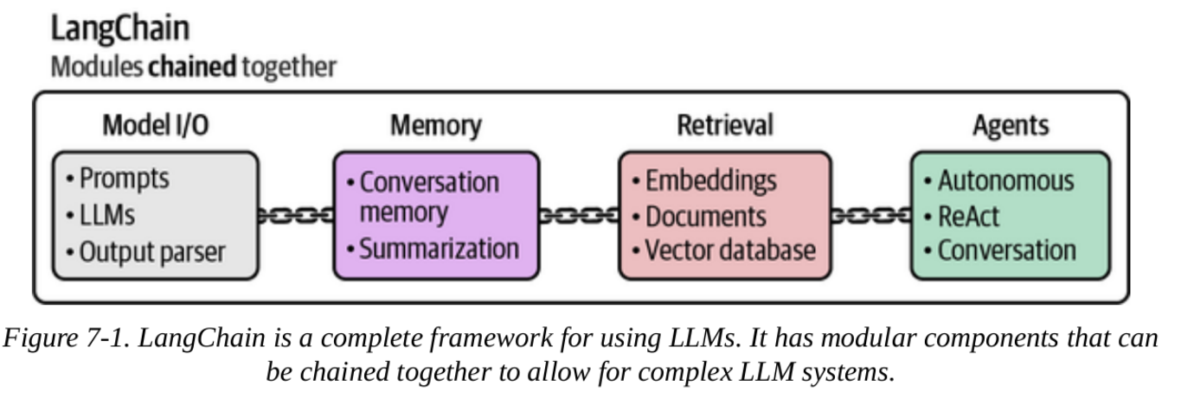
Using LangChain
In this chapter, we will see example of the methods mentioned in the last slide using LangChain.
LangChain is a framework designed to simplify the creation of applications using LLMs.

Slide 4
Model I/O: Loading Quantized Models with LangChain
As in previous chapters, we will be using Phi-3
This time we will use the GGUF (GPT-Generated Unified Format)
A GGUF model represents a compressed version of the original model
This is achieved using a method called quantization.

Slide 5
Model I/O: Loading Quantized Models with LangChain
What is Quantization?
Quantization reduces the number of bits required to represent the parameters of an LLM while attempting most of the original information.
This could cause some reduction in precision.
But this loss is made up for in speed, and lower resource needs

Slide 6
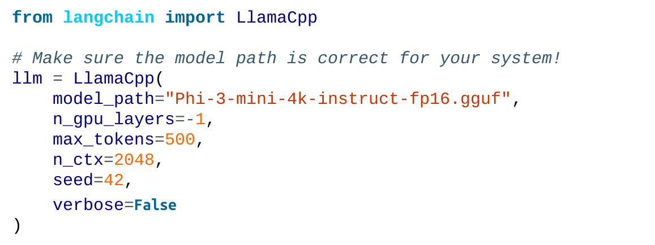
Model I/O: Loading Quantized Models with LangChain
For this chapter, we will be using the 16-bit variant
We use llama-cpp-python with LangChain to load the GGUF file:

Slide 7

Model I/O: Loading Quantized Models with LangChain
In LangChain, we use the invoke function to generate output:
As you can see, there is no output.
Looking back to the previous chapters, we know Phi-3 requires a specific prompt template.

Slide 8
Model I/O: Loading Quantized Models with LangChain
But instead of having to use this template every time,
We could instead use LangChain's core functionality, called 'chains'.

Slide 9
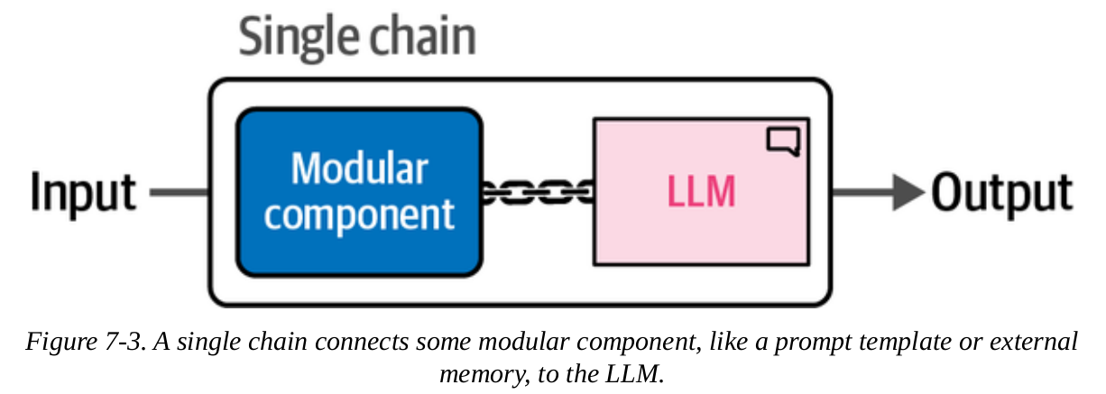
Chains: Extending the Capabilities of LLMs
The most basic form of a chain in LangChain is a single chain.

Slide 10
A Single Link in the Chain: Prompt Template
The template for Phi-3 is comprised of four main components:
<s> to indicate when the prompt starts
<|user|> to indicate the start of the user's prompt
<|assistant|> to indicate the start of the model's output
<|end|> to indicate the end of either the prompt or the model's output

Slide 11
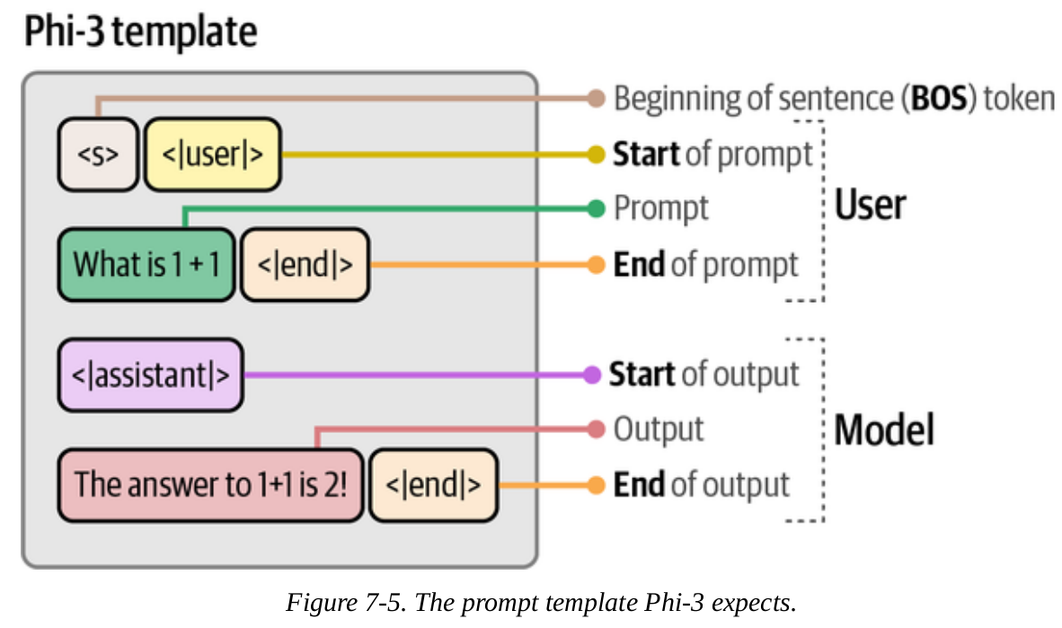
A Single Link in the Chain: Prompt Template
The template for Phi-3 is comprised of four main components:

Slide 12
A Single Link in the Chain: Prompt Template
Let's try this with a real example:
To generate our simple chain, we need to create a template that follows Phi-3s expected format.
The model takes in system_prompt, which describes what we expect from the LLM.
But we use input_prompt for specific questions

Slide 13
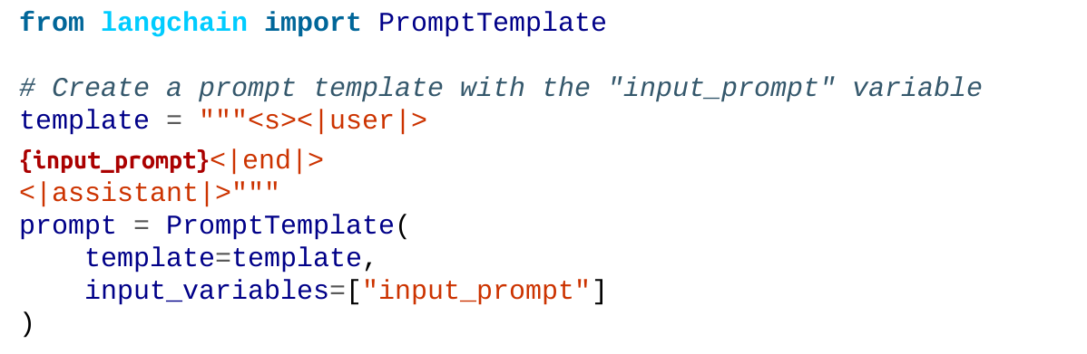
A Single Link in the Chain: Prompt Template
Let’s create the template:

Slide 14
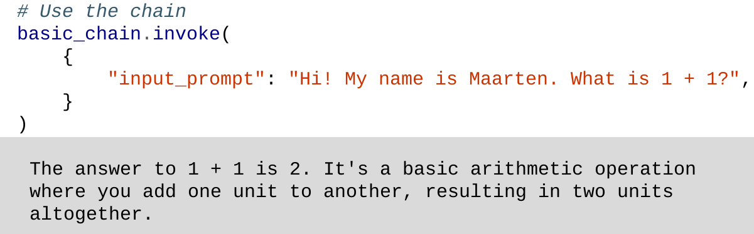
A Single Link in the Chain: Prompt Template
To create our first chain, we can use both the prompt that we created and the LLM and chain them together:
To use the chain, we need to use the invoke function

Slide 15
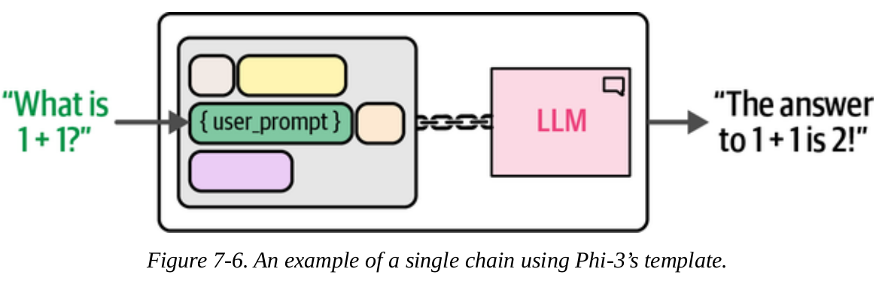
A Single Link in the Chain: Prompt Template

Slide 16
A Chain with Multiple Prompts
In the previous example, we created a single chain consisting of a prompt template and an LLM.
Because the prompt was straightforward, the model was able to handle it with no issues.
This is not always the case, some prompts contain multiple tasks and require ‘reasoning’.
For these prompts, it is suitable to use a chain with multiple prompts.

Slide 17
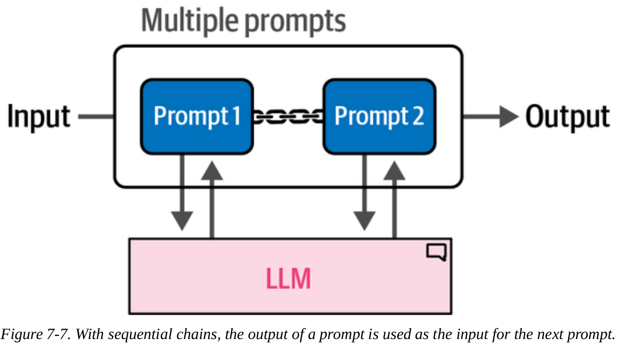
A Chain with Multiple Prompts

Slide 18
A Chain with Multiple Prompts
Let’s see how this works with an example. In this example, we want to generate a story that has three components:
A title
A description
A summary of the story

Slide 19
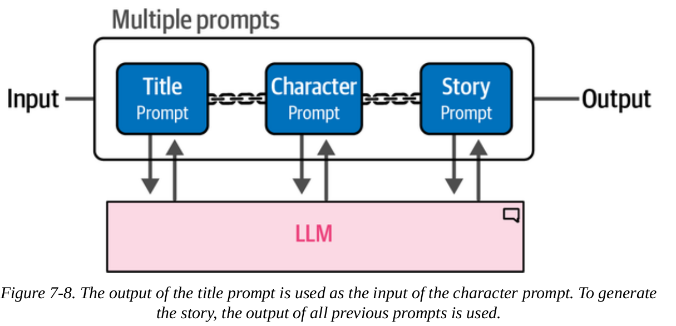
A Chain with Multiple Prompts
To generate that story, we use LangChain to describe the first component.
This is the first link, and is the only component that requires user input, the “summary”.

Slide 20
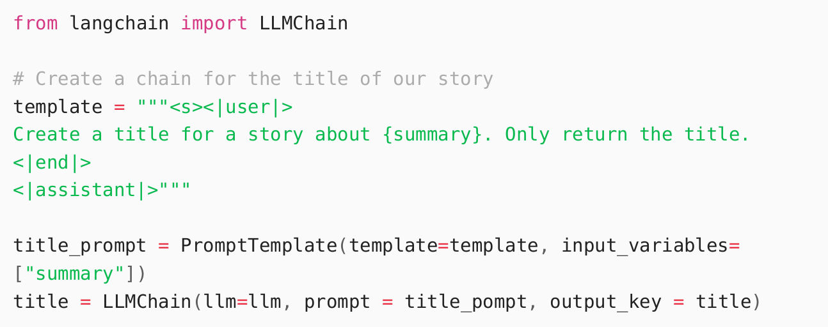
A Chain with Multiple Prompts
Let’s see this work using LangChain and Python

Slide 21
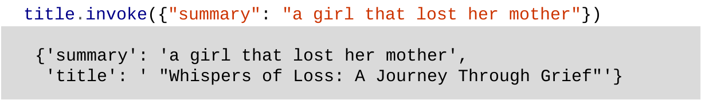
A Chain with Multiple Prompts
Let’s use the invoke function and provide our input to generate the story title.
Note that we can see both the input ("summary") as well as the output ("title").

Slide 22
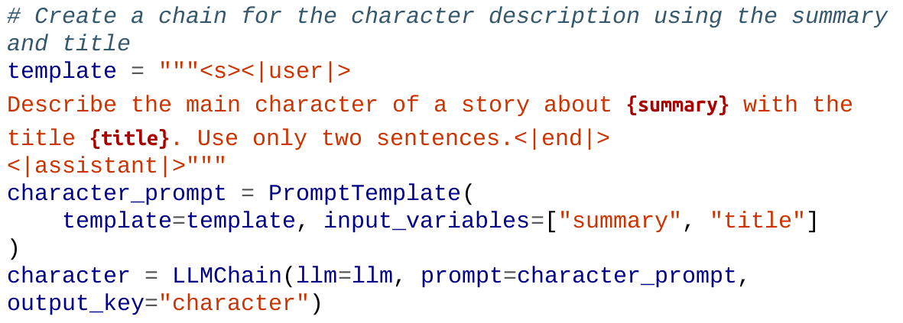
A Chain with Multiple Prompts
Using the generated output, let's generate the next component, the main character "description"

Slide 23
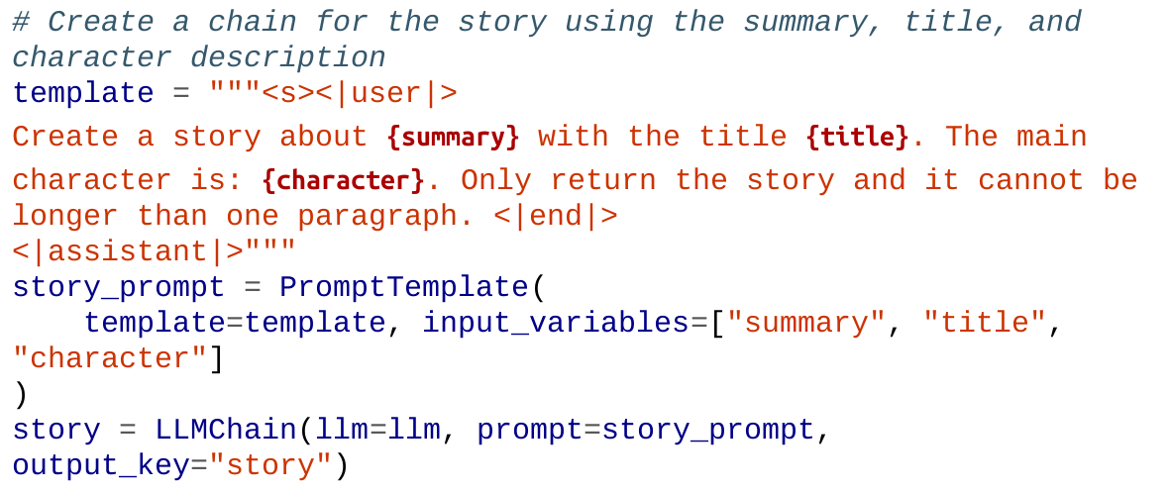
A Chain with Multiple Prompts
Using the generated output, let's generate the next component, the story "description"

Slide 24
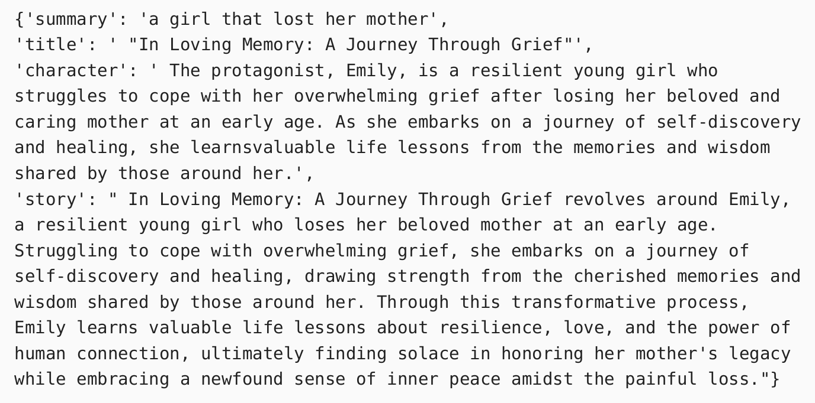
A Chain with Multiple Prompts
Now that we have created all three components, we can link them together to create our full chain to create the full story:

Slide 25
A Chain with Multiple Prompts
Running this chain gives us all three components.
This only required us to input a single short prompt, the summary.
Another advantage of dividing the problem into smaller tasks is that we now have access to these individual components.
We can extract the title, for example, on its own.
This could be more helpful in longer and more complicated chains.

Slide 26
Memory: Helping LLMs to Remember Conversations
When we use LLMs out of the box (basic inference), they will not remember what was being said in a conversation.
Any information shared in one prompt will not be remembered in the next.
LLMs, on their own, have no memory.
In this section, we test different ways to apply some kind of memory using LangChain.

Slide 27
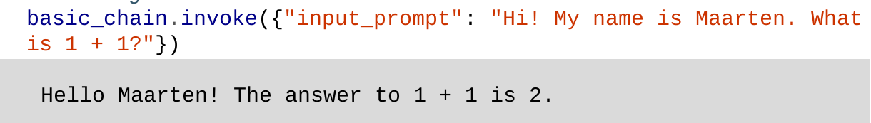
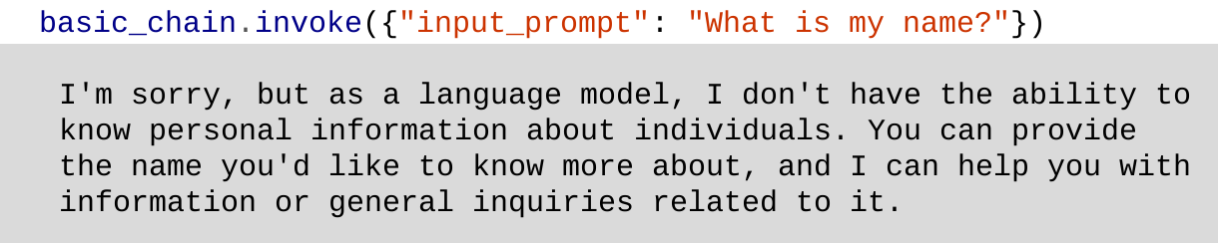
Memory: Helping LLMs to Remember Conversations
Let’s first test the forgetfulness of LLMs with code
Next, we ask it to reproduce the name we have given it:

Slide 28
Memory: Helping LLMs to Remember Conversations
LLMs are stateless, every transaction/action is handled as if it were the first time.
To address this, there are two common methods:
Conversation buffer
Conversation summary

Slide 29
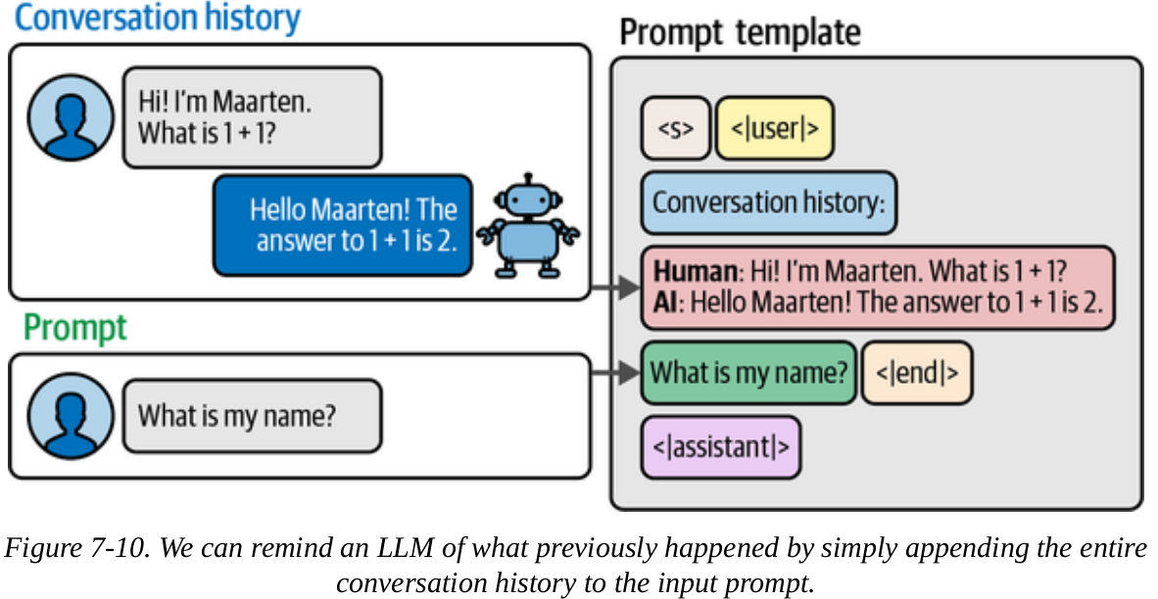
Conversation Buffer
What this method does is copy the full conversation history and include it in the prompt.

Slide 30
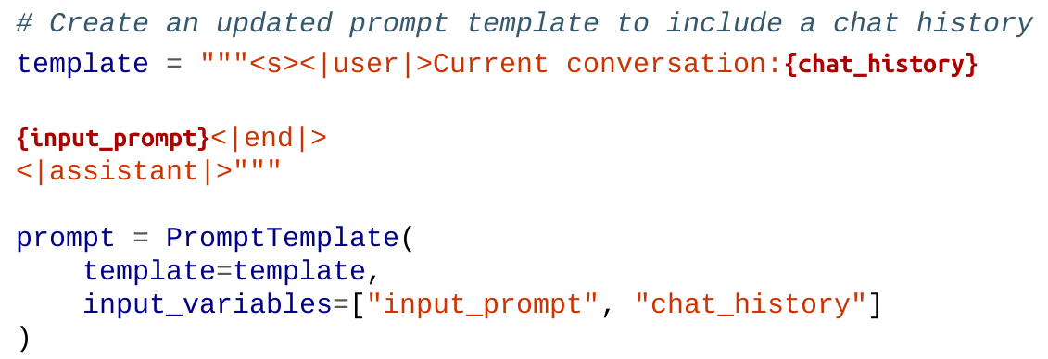
Conversation Buffer
In LangChain, this form of memory is called ConversationBufferMemory
Here, chat_history is defined internally by LLMChain

Slide 31
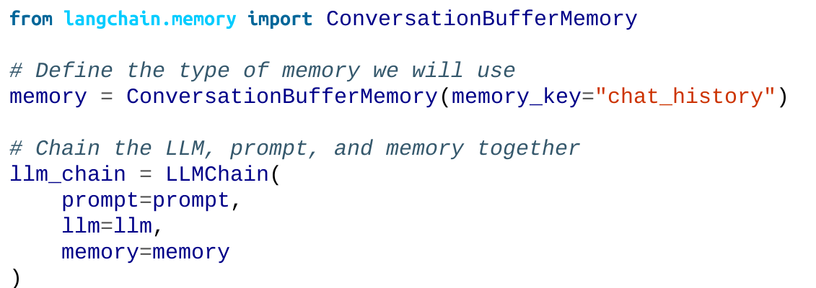
Conversation Buffer
Next, we can create LangChain’s ConversationBufferMemory and
assign it to the chat_history input variable.
ConversationBufferMemory will store all the conversations we have

Slide 32
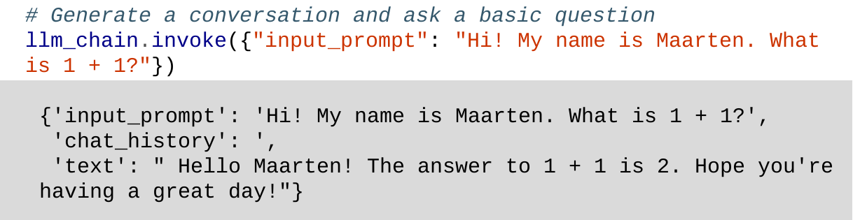
Conversation Buffer
Let’s check whether we did this correctly:
You can find the generated text in the text key, the input prompt in input_prompt, and the chat history in chat_history.
As you can see, chat_history: , there is no chat history as this is the first time we used this specific chain.

Slide 33
Windowed Conversation Buffer
While using the entire previous chat history as an input is effective in retrieving information and creating memory, this creates a problem.
As the conversation progresses, the higher the number of tokens is used in the conversation
This makes it faster to reach the context window limit
Recall that context window is the number of total tokens a model can take in as input.

Slide 34
Windowed Conversation Buffer
To address this limitation, we can use ConversationBufferWindowMemory
ConversationBufferWindowMemory allows the user to decide how many (k) past conversations are included in the memory.

Slide 35
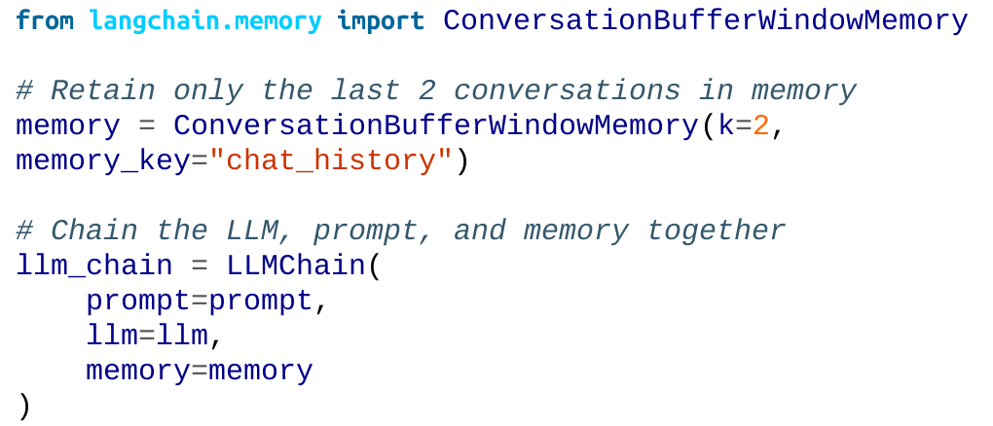
Windowed Conversation Buffer
Let’s try ConversationBufferWindowMemory

Slide 36
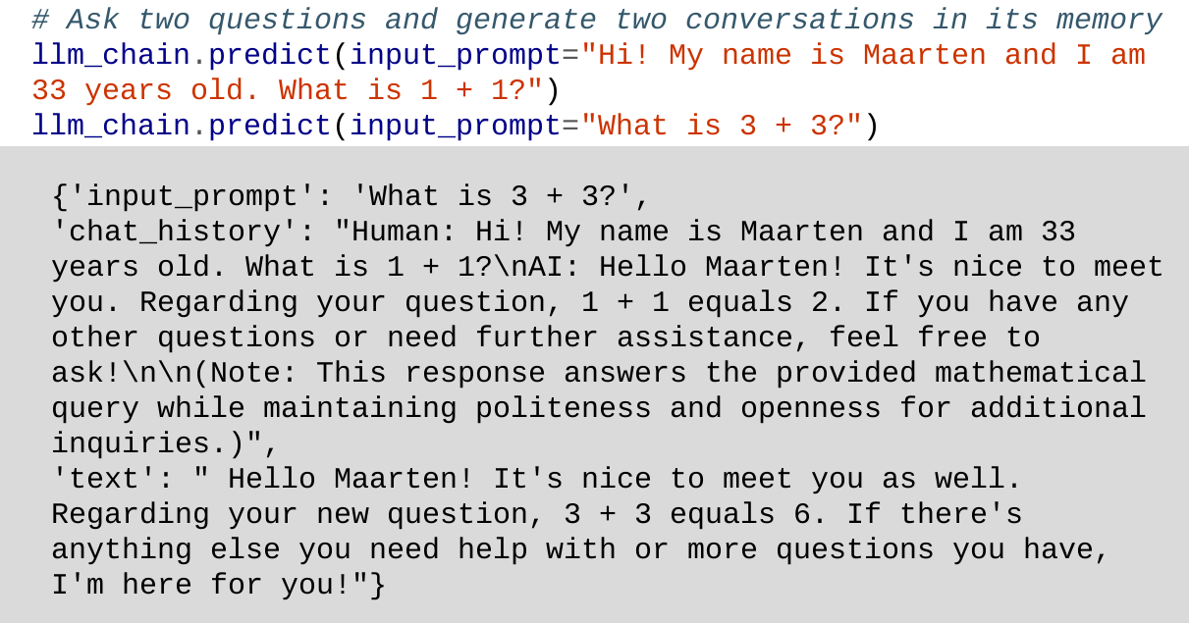
Windowed Conversation Buffer
Let's try out a series of questions:

Slide 37
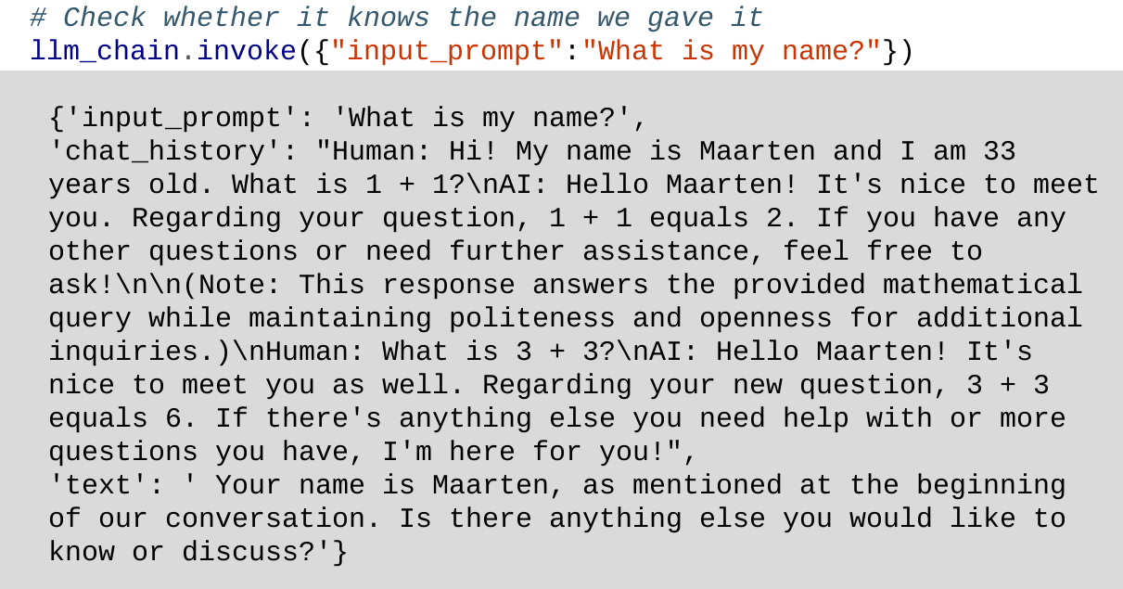
Windowed Conversation Buffer
Let's check whether it can answer a question regarding the name:

Slide 38
Windowed Conversation Buffer
Based on the output in ' text ' it correctly remembers the name we gave it. The chat history is updated with the previous question.
We know that we set k = 2 for ConversationBufferWindowMemory , meaning we only retain information from the last 2 conversations.
Let's test this and see whether the model remembers the age we provided (from 3 conversations before).

Slide 39
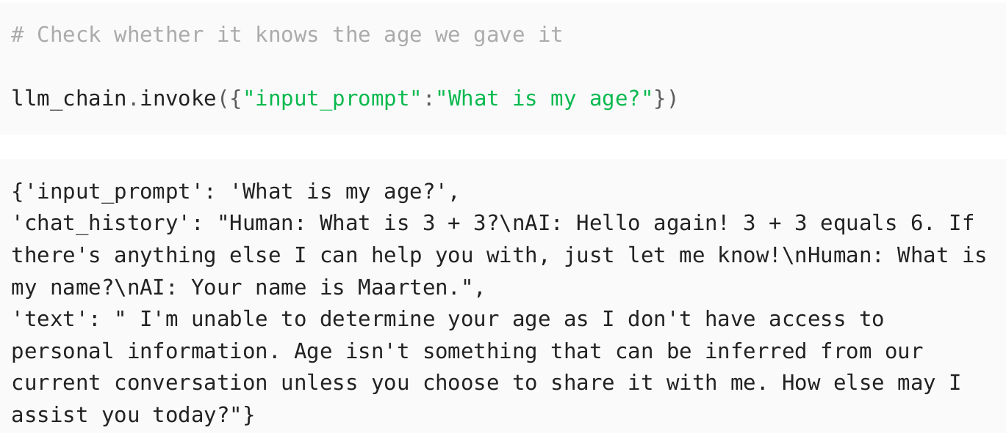
Windowed Conversation Buffer
As you can see in the response, the LLM outputs the expected information. It doesn't have access to the age information.

Slide 40
Windowed Conversation Buffer
ConversationBufferWindowMemory is effective in use cases where conversations are short
But fails in retrieving possibly important information
This limitation is addressed by Conversation Summary

Slide 41
Conversation Summary
We see that the last 2 ways we can retain memory have issues, both regarding the context window limit.
Conversation Summary completely addresses this.
It is a technique that summarizes an entire conversation history to distill it into the main points.
This gets rid or significantly reduces the impact of the number and the length of previous conversations.

Slide 42
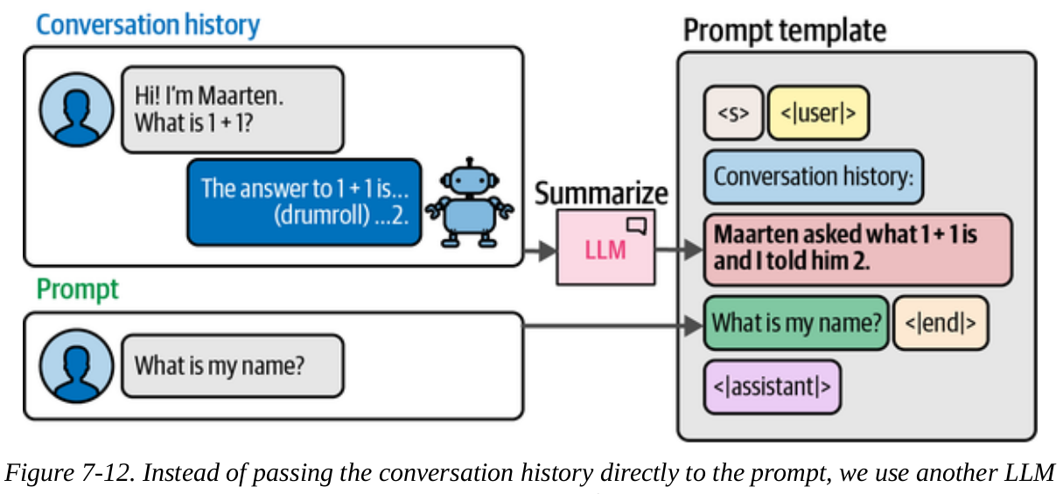
Conversation Summary
The summarization process is handled by an external LLM. It is given the entire conversation history as input and asked to create a concise summary.

Slide 43
Conversation Summary
Because we need an external LLM for summarization, we make 2 calls whenever we ask the LLM:
The user prompt
The summarization prompt

Slide 44
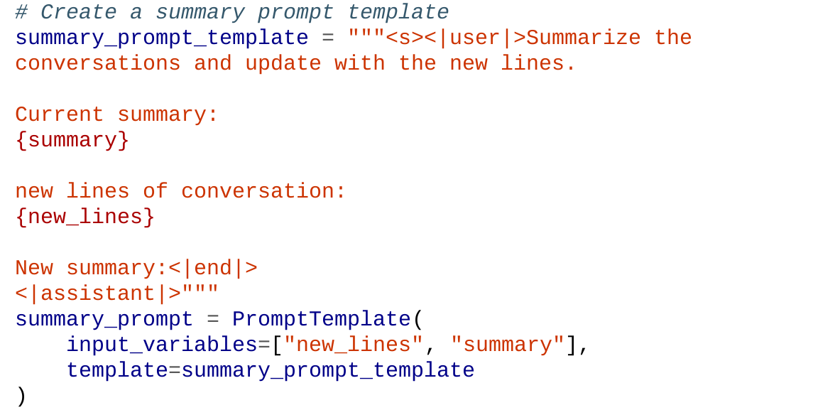
Conversation Summary
To use this in LangChain, we first need to prepare a summarization template that we will use as the summarization prompt:

Slide 45
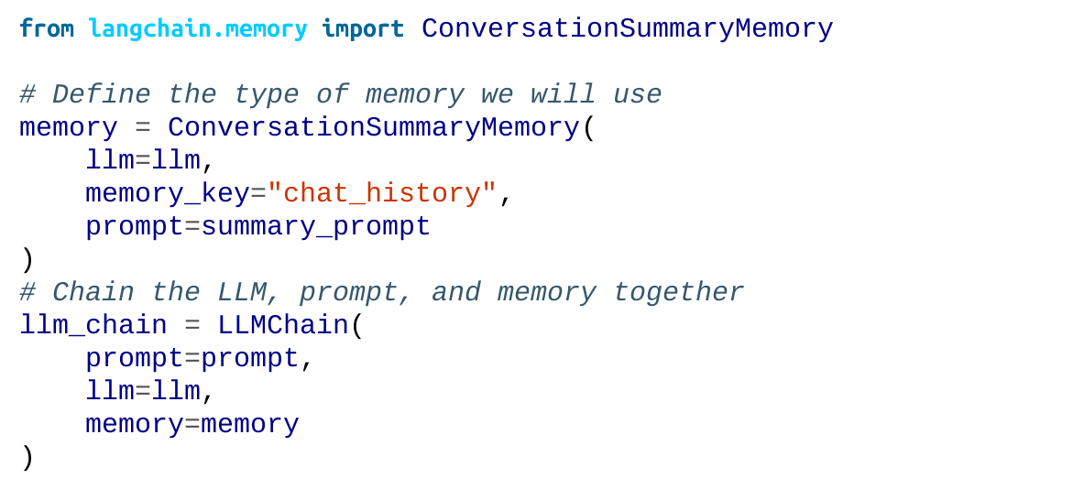
Conversation Summary
Using ConversationSummaryMemory in LangChain is similar to what we did previously.

Slide 46
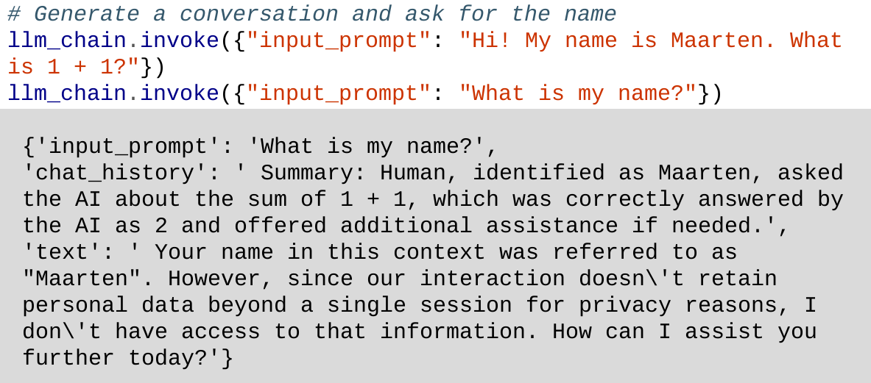
Conversation Summary
Let's test out its summarization capabilities:

Slide 47
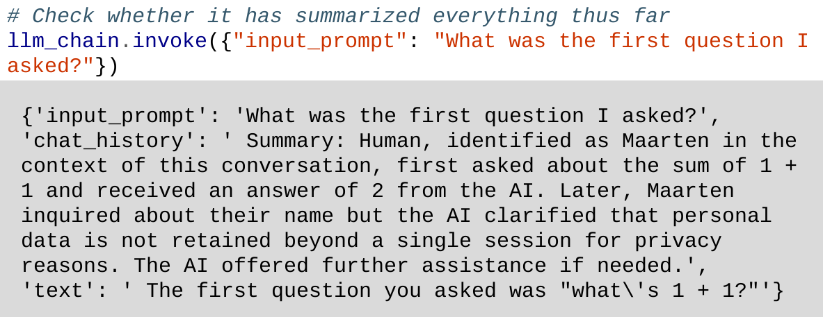
Conversation Summary
After each step, conversations are summarized up to that point.
To get the most recent summary, we can access the memory variable we created previously:

Slide 48
Conversation Summary
This decreases the tokens used in the conversation by a lot.
But the model would need to infer information from context since it doesn't have the explicit statements and queries.
Also, multiple calls to the same LLM are needed, one for the prompt and one for the summarization.
This can slow down the overall response generation.

Slide 49
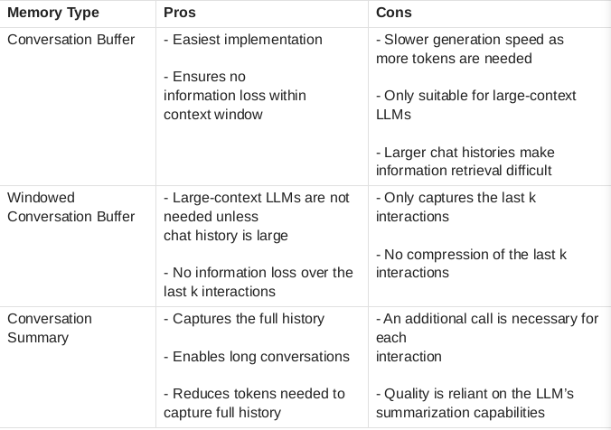
Conversation Summary
Choosing between ConversationSummaryMemory and ConversationBufferMemory is about speed, accuracy, and memory.

Slide 50
Agents: Creating a System of LLMs
Agents are systems that leverage a language model to determine which actions to take.
Agents can make use of everything we've discussed so far (I/O, chains, and memory).
It has 2 vital components:
Tools that agents can use to do things that it wouldn't be able to do on its own
The agent type, which plans the action to take or tools to use.

Slide 51
Agents: Creating a System of LLMs
Unlike chains, agents are more able and can do things like creating and self-correcting.
For example, instead of asking an LLM to solve an equation, you can give it access to a calculator (tool).
By providing LLMs with multiple tools, they would have the ability to choose the best tool for a specific query.

Slide 52
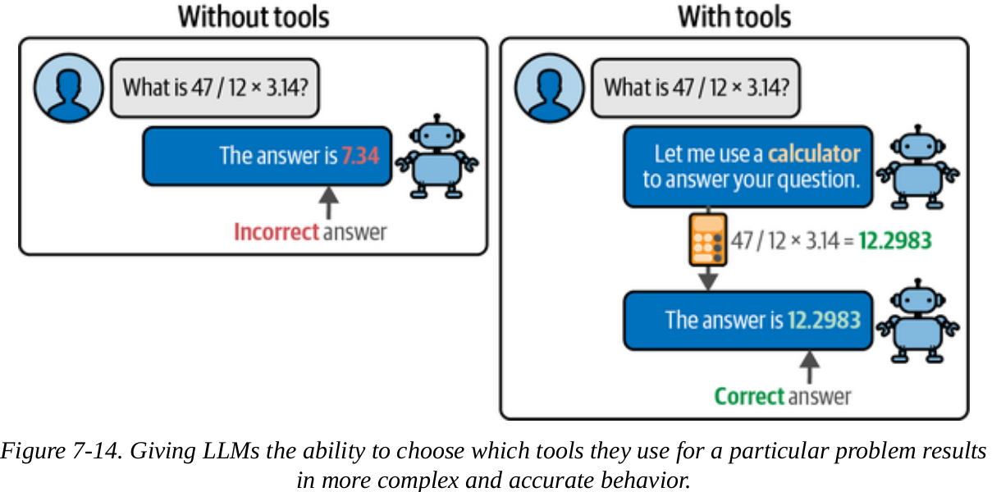
Agents: Creating a System of LLMs

Slide 53
The Driving Power Behind Agents: Step-By-Step Reasoning
LLMs have “reasoning” abilities, but can’t act on their own.
To be able to act, thy require specific queries.
ReAct merges these two concepts (Reasoning and Acting) to allow reasoning to affect acting and allow acting to affect reasoning.
ReAct has 3 steps:
Thought
Action
Observation

Slide 54
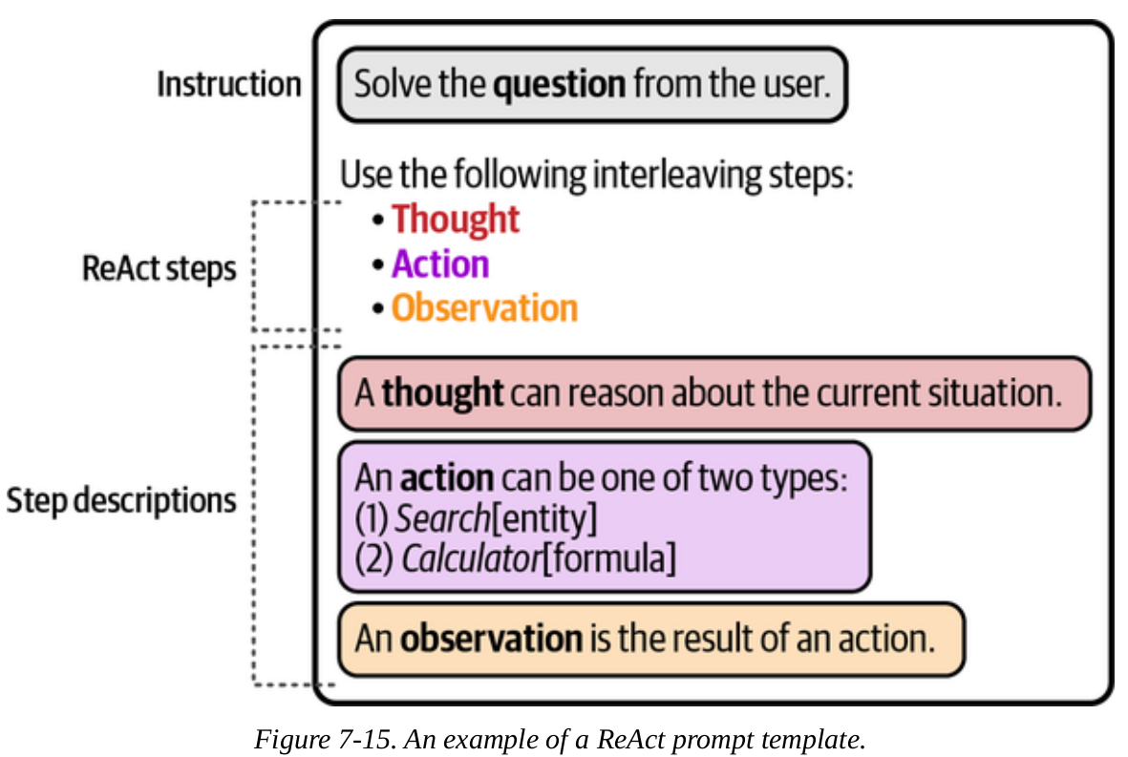
The Driving Power Behind Agents: Step-By-Step Reasoning
The ReAct framework is illustrated below

Slide 55
The Driving Power Behind Agents: Step-By-Step Reasoning
As illustrated above, the LLM is asked to create a thought based on the input provided. (what to do next and why)
Based on the thought, an action is triggered. (external tool like a calculator or search engine)
Based on the result of using the tool, the observation of the output is made. (often a summary of whatever result it retrieved)

Slide 56
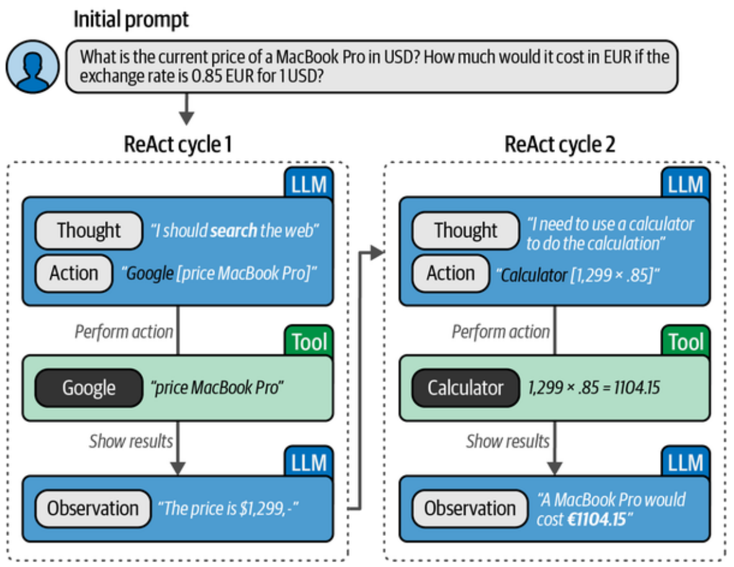
The Driving Power Behind Agents: Step-By-Step Reasoning
The steps described in the previous slide are illustrated here

Slide 57
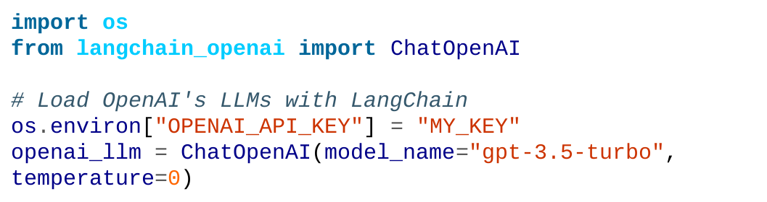
The Driving Power Behind Agents: Step-By-Step Reasoning
ReAct in LangChain
Let's build a pipeline that can search the web for answers and
perform calculations with a calculator.

Slide 58
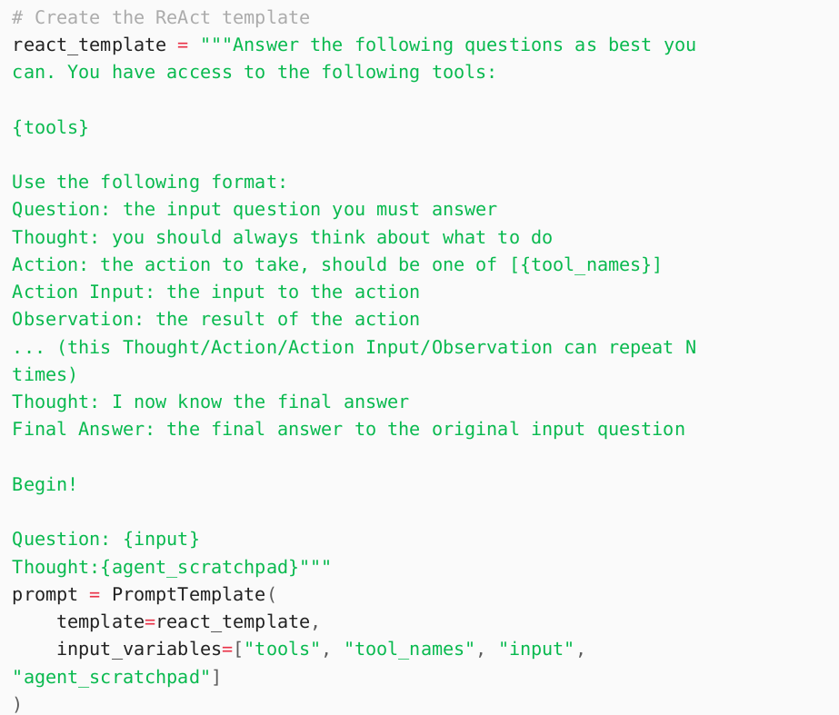
The Driving Power Behind Agents: Step-By-Step Reasoning
Let's create the template for ReAct:

Slide 59
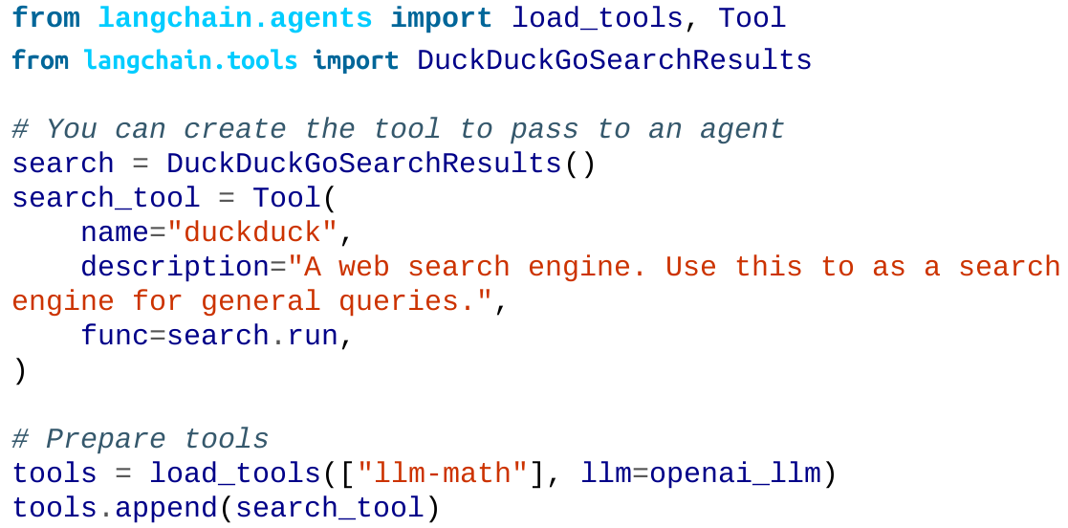
The Driving Power Behind Agents: Step-By-Step Reasoning
To enable it to interact with external tools better, we will describe what these tools are:

Slide 60
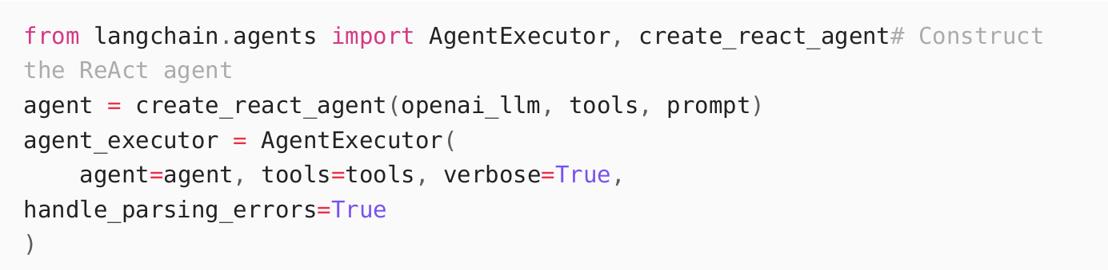
The Driving Power Behind Agents: Step-By-Step Reasoning
Now that we have defined everything we need, let's create the ReAct agent and pass it to the AgentExecutor , which handles executing the steps:

Slide 61
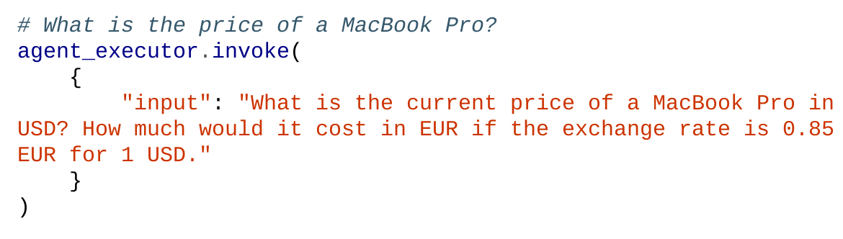
The Driving Power Behind Agents: Step-By-Step Reasoning
Let's test whether this works:

Slide 62
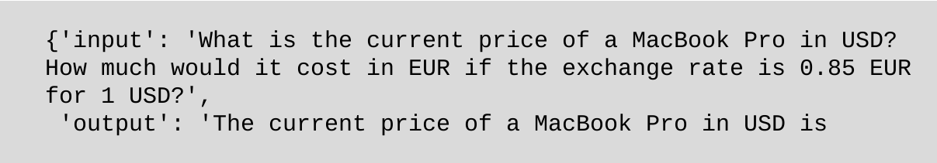
The Driving Power Behind Agents: Step-By-Step Reasoning
When finished, the model gives an output like this:

Slide 63
The Driving Power Behind Agents: Step-By-Step Reasoning
Summary:
ReAct guides LLMs through a cyclical Thought/Action/Observation process to solve complex queries.
Requires a structured template defining the reasoning format and available tools (search, calculator, etc.).
AgentExecutor manages iterative execution, connecting the LLM with external tools.
Agent autonomously breaks down queries into steps, using tools until reaching a final answer.

Slide 64
END

